Slide 1


Bank of Baroda
Hackathon - 2022
Technology Partner
Call Centre Analytics
Team Name : Seal Team 6

Slide 2
Table Of Contents
01
02
03
Problem Overview
Pain Points
Azure tools
Overview of the problem statement
Customer problems and user segment
Azure resources and tools used in the project
04
05
06
Text Analytics
Solution Overview
Business Analytics
Visual representations and KPIs calculation
Solution Methodology and Architecture
Scalability and scope of project

Slide 3
Problem Statement
Why did we decide to solve this problem statement?
The problem being addressed is analysing various call recordings by converting speech to text and then performing sentiment analysis and estimating user satisfaction.
We chose this problem statement because of its wide application. With India being home to many regional and native languages, it is a major problem of understanding what the user speaks. By performing speech translation we can bridge the language gaps between customers and users.
Another reason for choosing this problem statement is looking at the business perspective. By performing sentiment analysis and analysing calls to estimate customer satisfaction, the companies will be able to make both qualitative and quantitative use of the data that is available to them.
The third reason is its wide scalability. This problem of speech recognition is not only used in call centres but also in many places like interactions in hospitals, colleges, music industry etc.

Slide 4
Pain Points
User Segment
Customer Problems
Users of Product
Analytics and KPIs
Customers speak in their local languages, unable to understand by service providers. Customers’ queries and satisfaction, Lack of awareness of service providers.
Extensively used by service providers like bank of baroda who have huge call center network for customer queries and feedback.
End to end analysis of customer satisfaction and important KPIs to help analyse the calls and improve the services provided to customers.

Slide 5
Azure Tools and Resources
Auto Detect Source Language Config
Speech Recognizer
This library helps us to detect languages in the audio. As, our audio contains mixture of languages, We use Continuous LID provided by Azure to identify multiple languages for the duration of the audio.
We use speechsdk’s SpeechRecognizer after identifying the language in an audio source, to transcribe the audio/ speech to text.
Translation Recognizer
Text Analytics
After recognizing the language in the audio and transcribing the audio to text, we then translate the entire call recording to a common language english using Azure’s TranslationRecognizer.
Lastly, we use azure.ai.textanalytics to perform sentiment analysis and opinion mining to understand positive and negative sentiments of the speaker and calculate KPIs like customer satisfaction etc.

Slide 6
Text Analytics
We intend to estimate following KPIs with the use of text we obtain:
Average Hold Time (AHT)
First Call Resolution (FCR)
Customer Satisfaction (CSat)
Average Talk Time
We also try to present various other analysis from text such as:
Word Maps
Time Series Graphs
Sentiment analysis

Slide 7
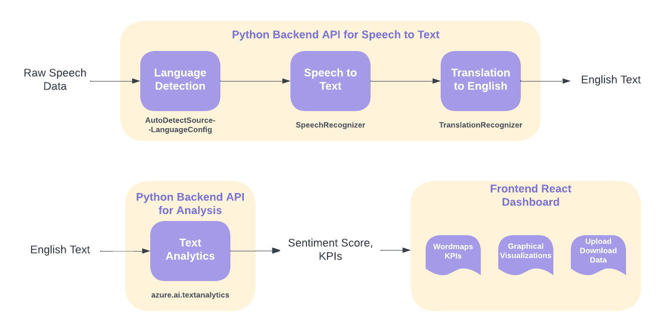
Solution Methodology and Architecture

Slide 8
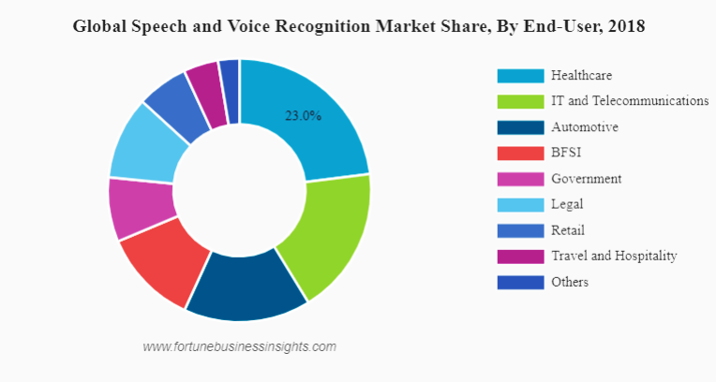
Business Analysis
Speech recognition and translation has a huge demand and market and is being used in almost every sphere.
Our solution is cost effective as it relies on free and highly efficient Azure APIs and Open source libraries to create dashboard.
It is user-friendly and scalable and sentiment analysis can be used for analysing customer trends and demands which is a major factor of growth in any company.

Slide 9



Thank You
Shirin Jain IIT Guwahati
Shiv Chauhan IIT Guwahati
Snigdha Jain IIT Guwahati

